Slide 1
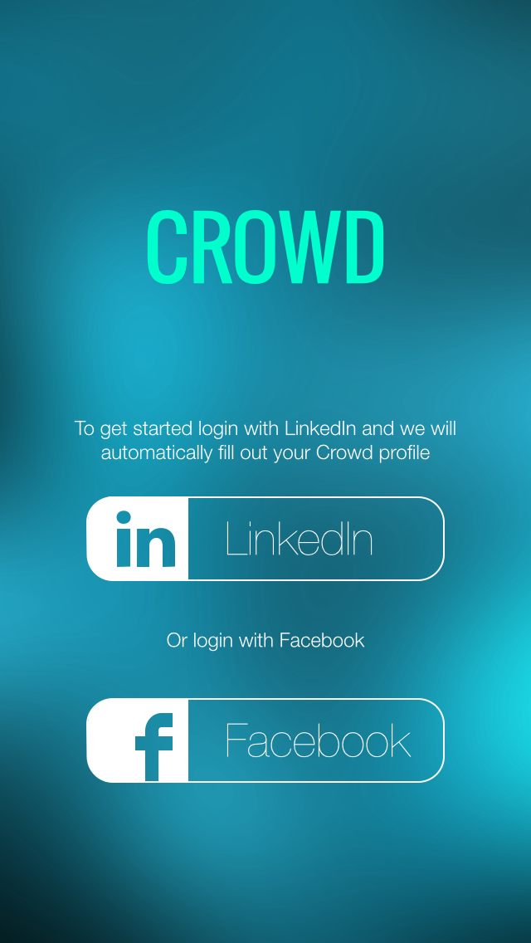
About this document:
This interactive document will enable you to walk through the app and the interactions.
This represents a work in progress, it will be continually updated with new designs and flows.

Slide 2
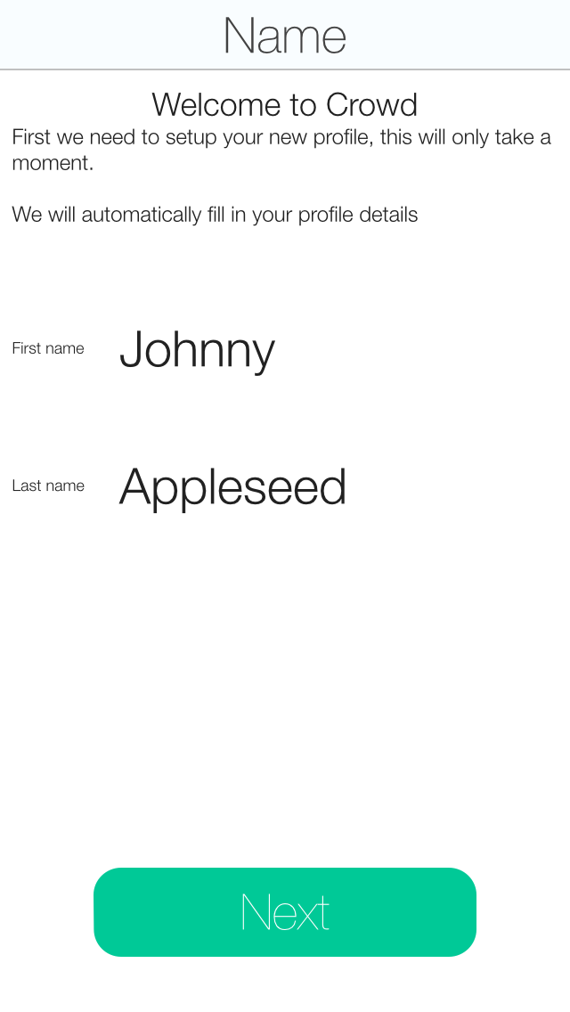
After logging into either network, the relevant data will be pulled and inserted into each category in creating a profile. The user can then modify some of the data if it makes sense to modify.

Slide 3
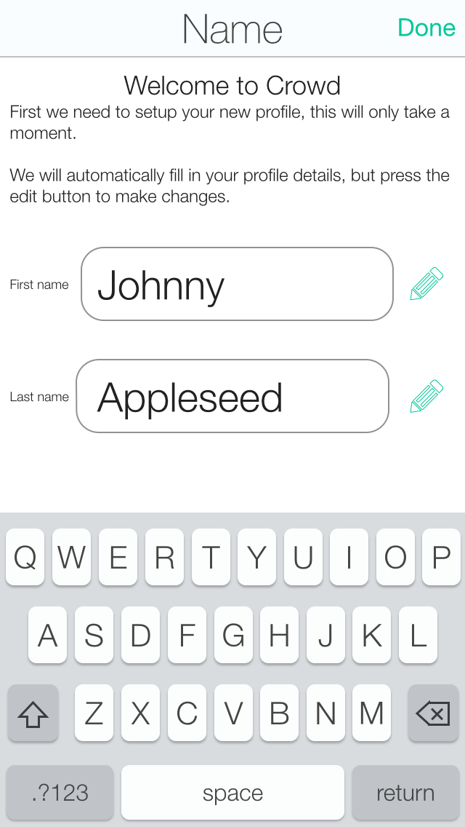
The user can edit the name fields, pressing Done ends the editing mode.

Slide 4
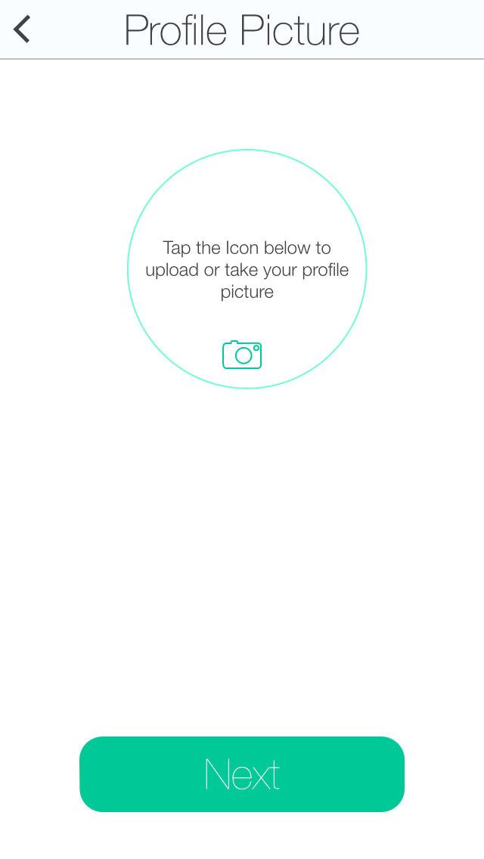
Here the user can take a new photo. Pressing on the camera icon will bring up the iOS camera.

Slide 5
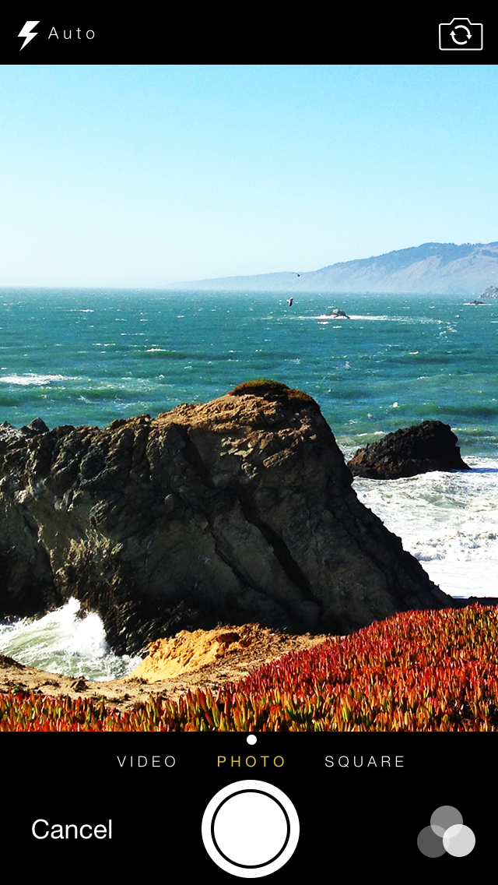
When taking a photo, the standard iOS camera view is used.

Slide 6
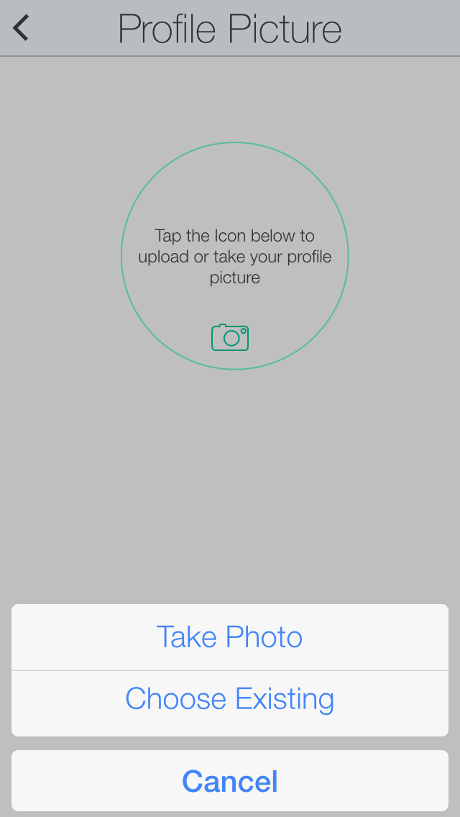
The user can choose to take a photo or choose an existing photo from the camera roll.

Slide 7
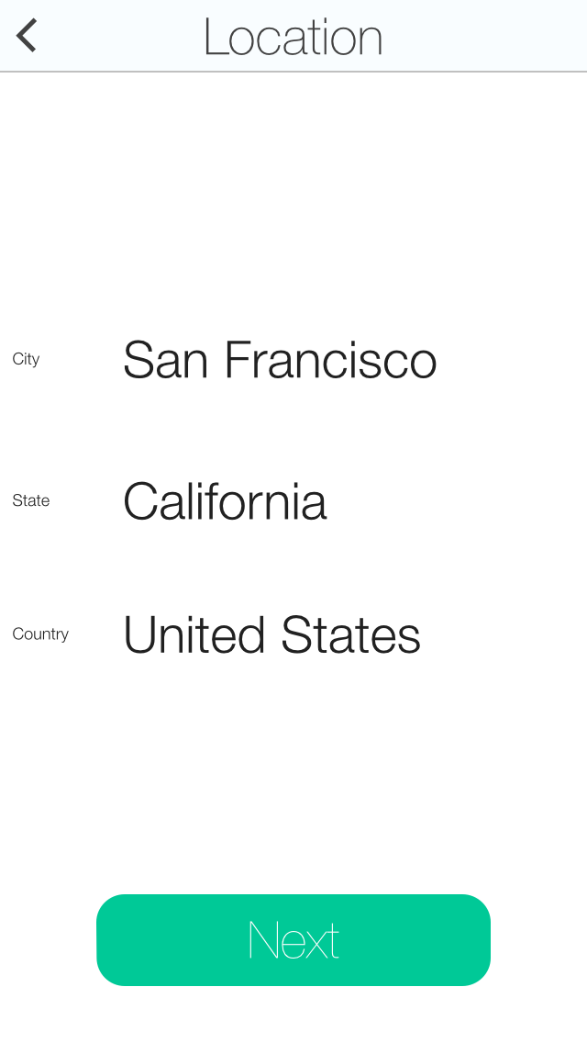
The user’s location.

Slide 8
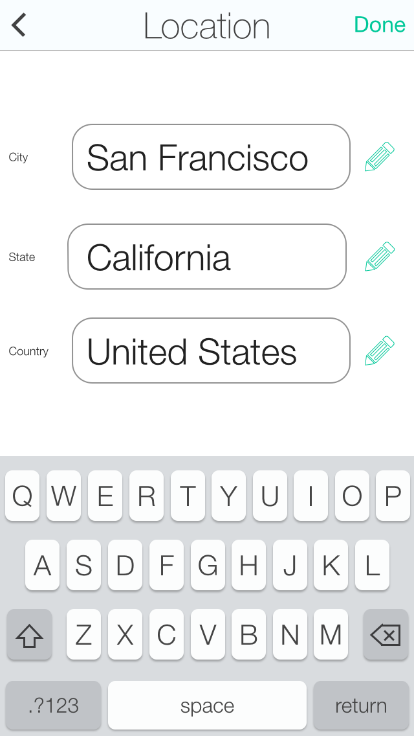
Each text field can be edited to fill out a City, State or Country.

Slide 9
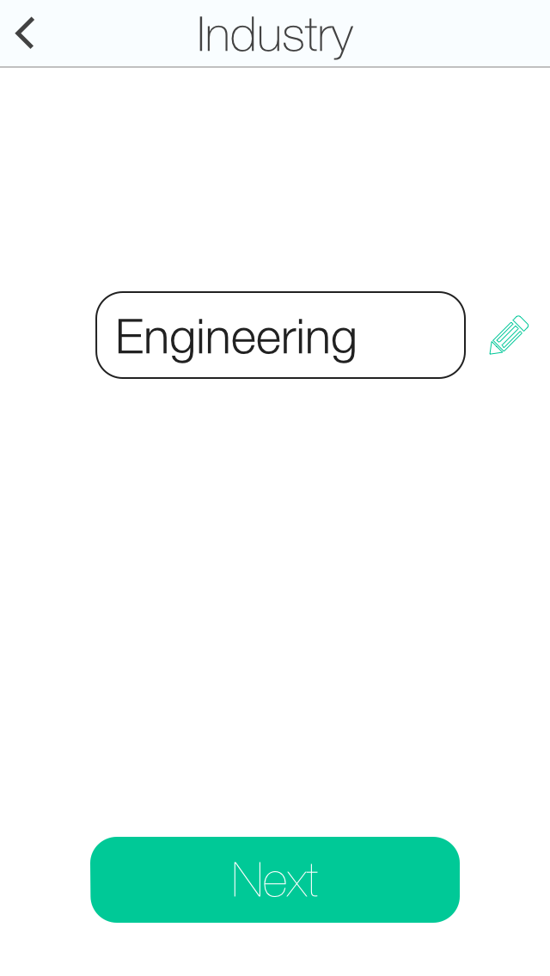
When picking an industry the user can tap on the pencil or textfield to select a different industry. This will bring up an alphabetical list of industries to select from.

Slide 10
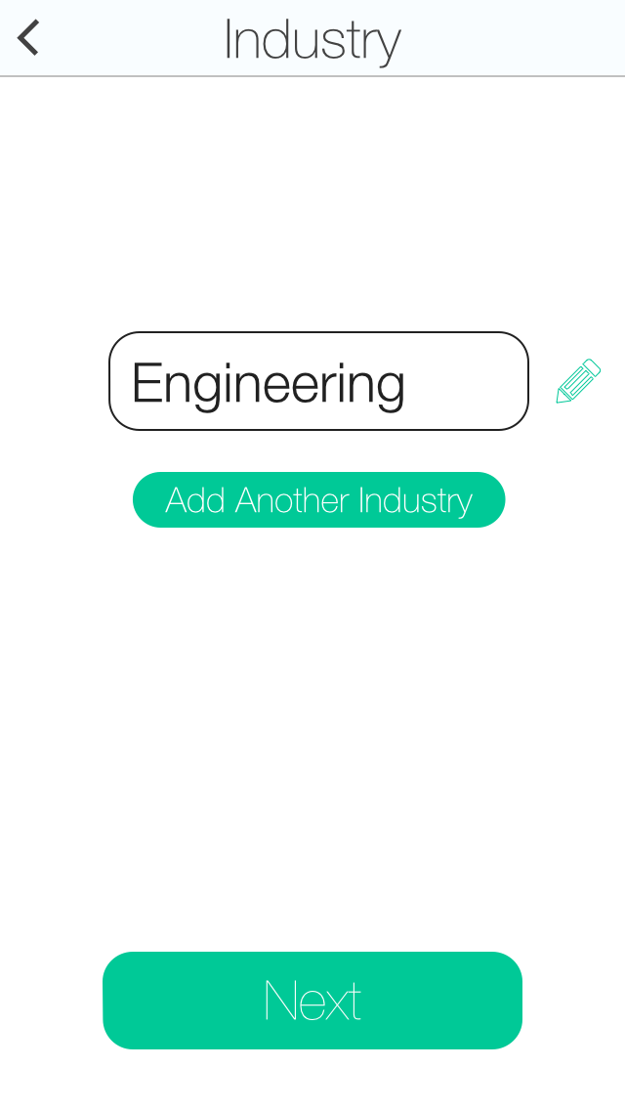
The user can add a 2nd Industry if they want, or proceed with Account creation.

Slide 11
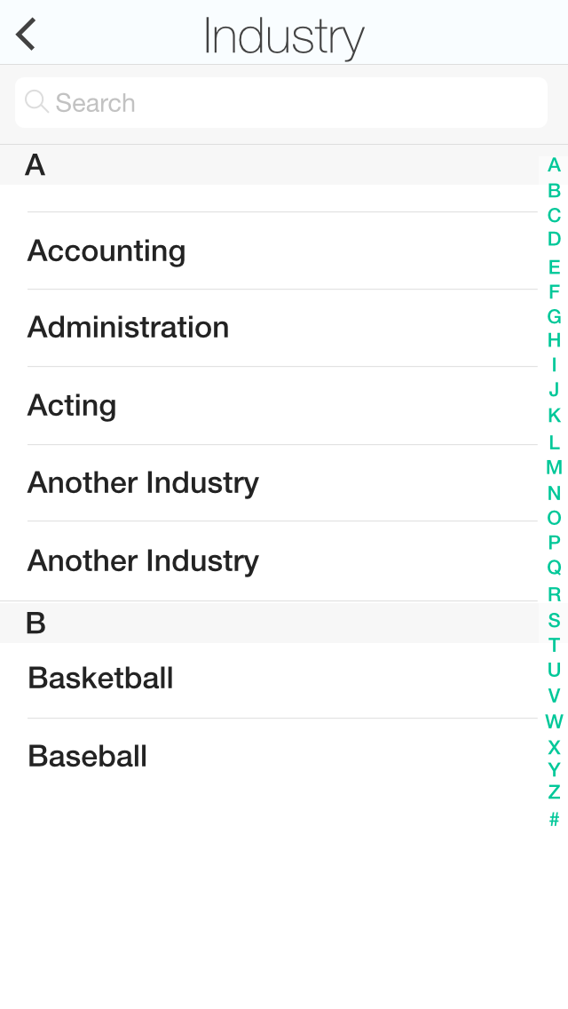
When picking an industry, the user can select from a very large list of possible choices. A search box at the top makes it fast to find the right industry.

Slide 12
When picking an industry, the user can select from a very large list of possible choices. A search box at the top makes it fast to find the right industry.

Slide 13
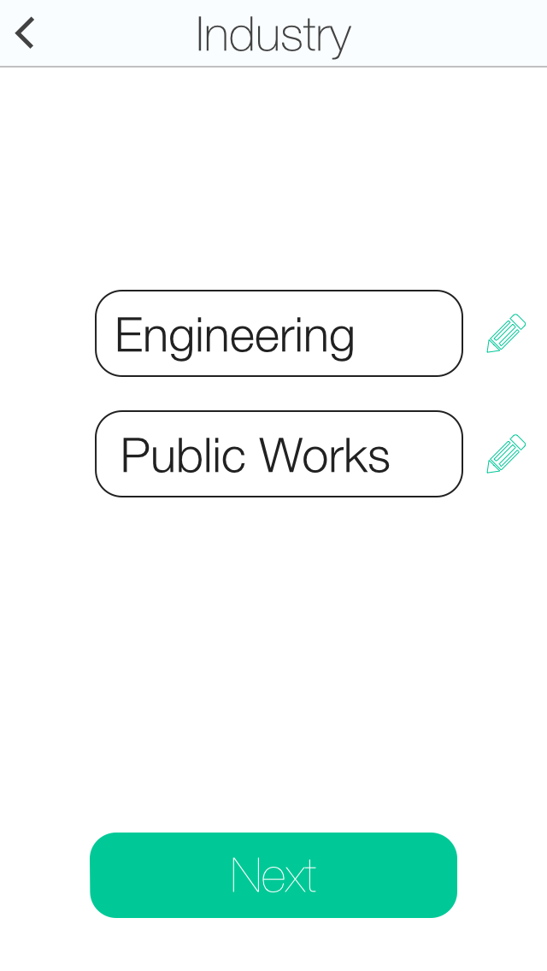
When picking an industry, the user can select from a very large list of possible choices. A search box at the top makes it fast to find the right industry.

Slide 14
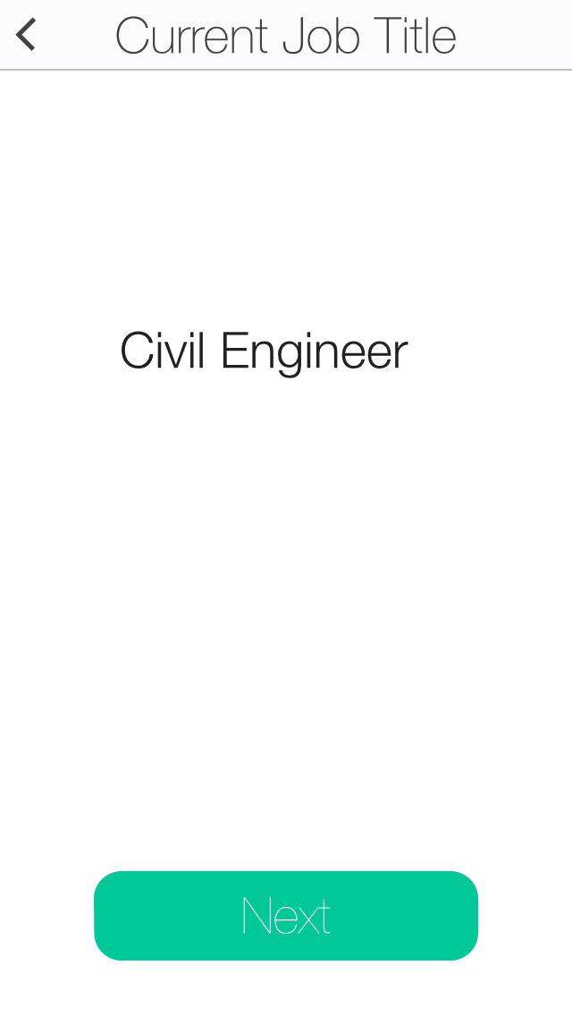
The current job from LinkedIn

Slide 15
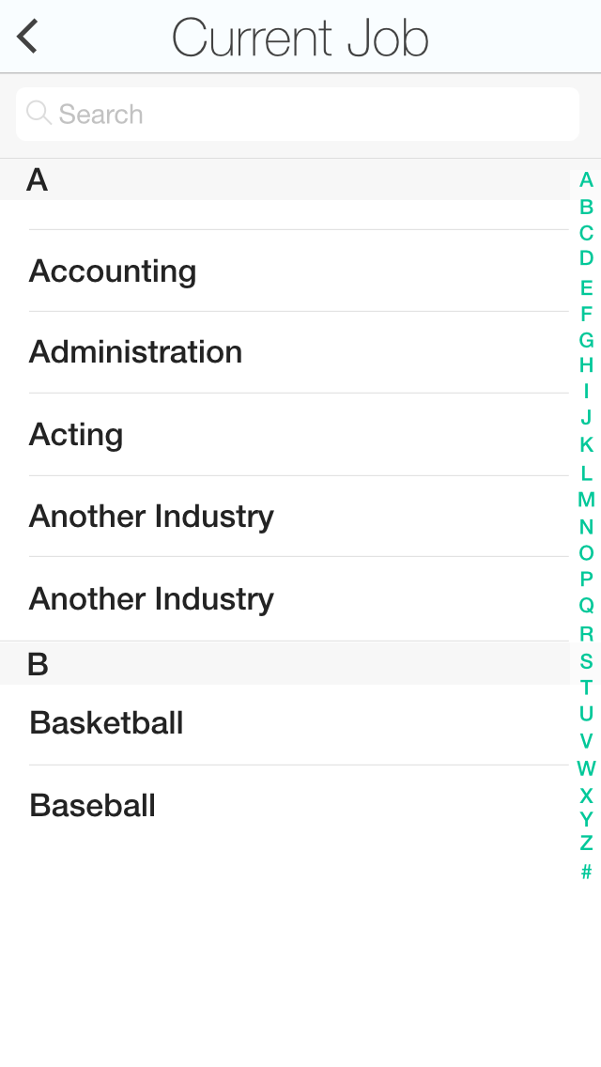
Just like the Industry, the job’s will be listed here.

Slide 16
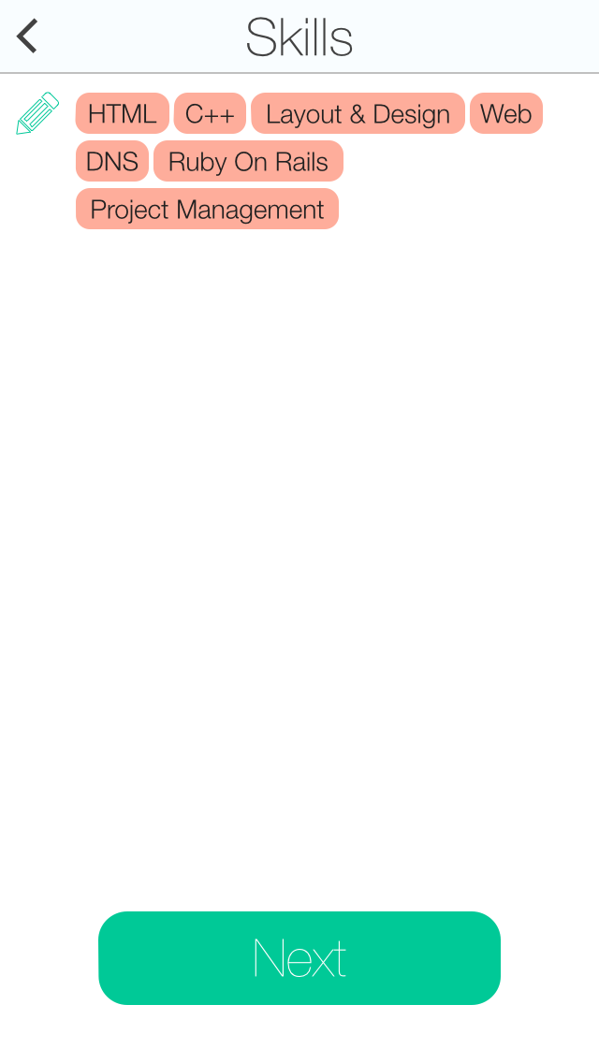
Skills will be pulled form LinkedIn, a user can add additional skills, each skill is encapsulated in a shell. Tapping on the pencil or on any skills will allow the user to list more skills.

Slide 17
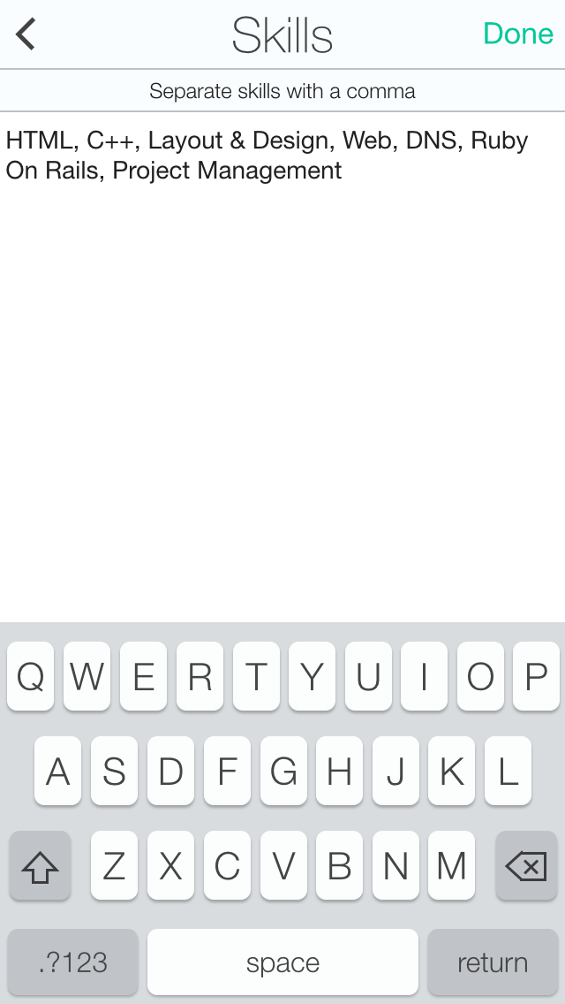
Skills can be entered in one at a time and separated by commas.

Slide 18
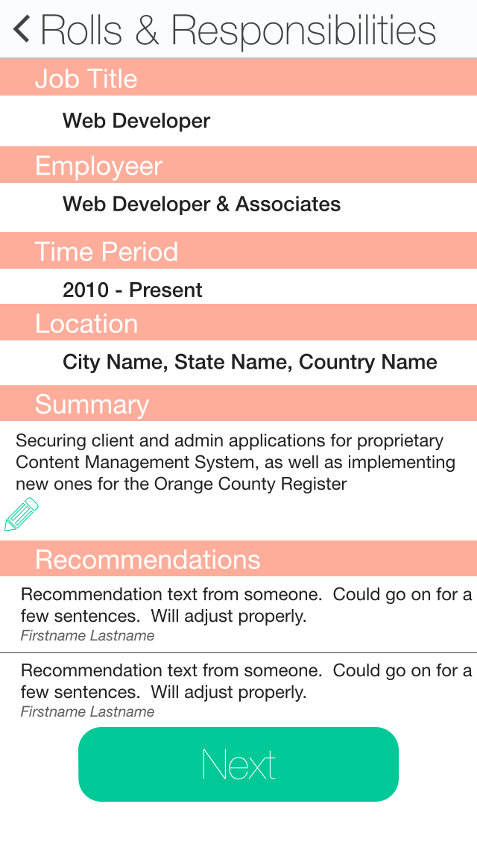
The work history will provide a Job Title, Employer, Time Period, Location, Summary of the job and Recommendations. Sections can be edited by tapping on the label or pencil button. If no recommendations are listed they will be skipped.

Slide 19
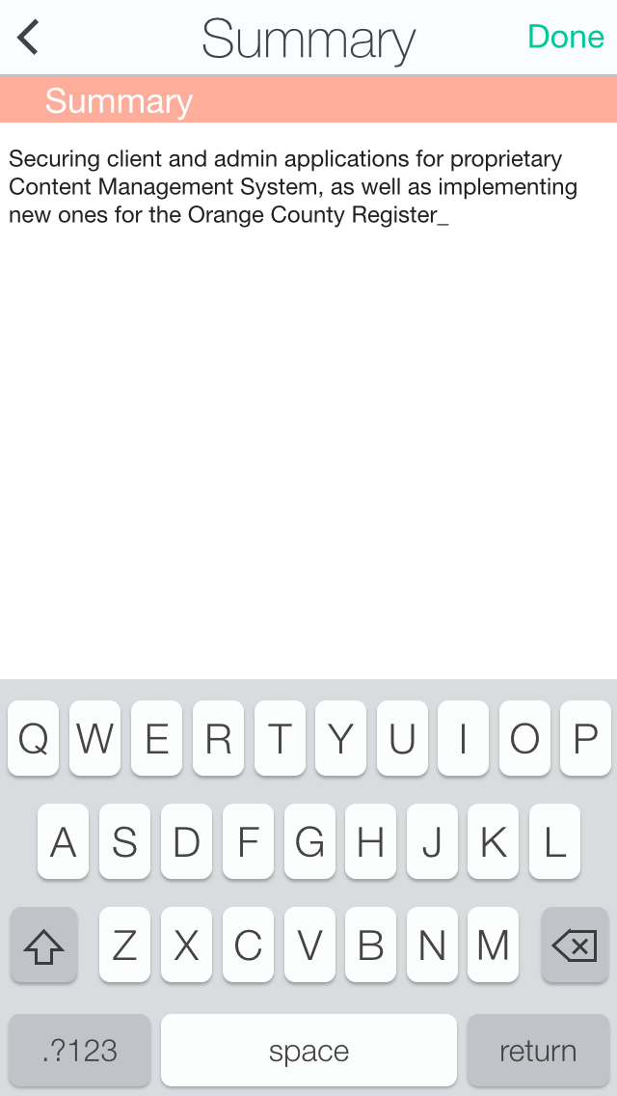
The Summary can be edited by the user.

Slide 20
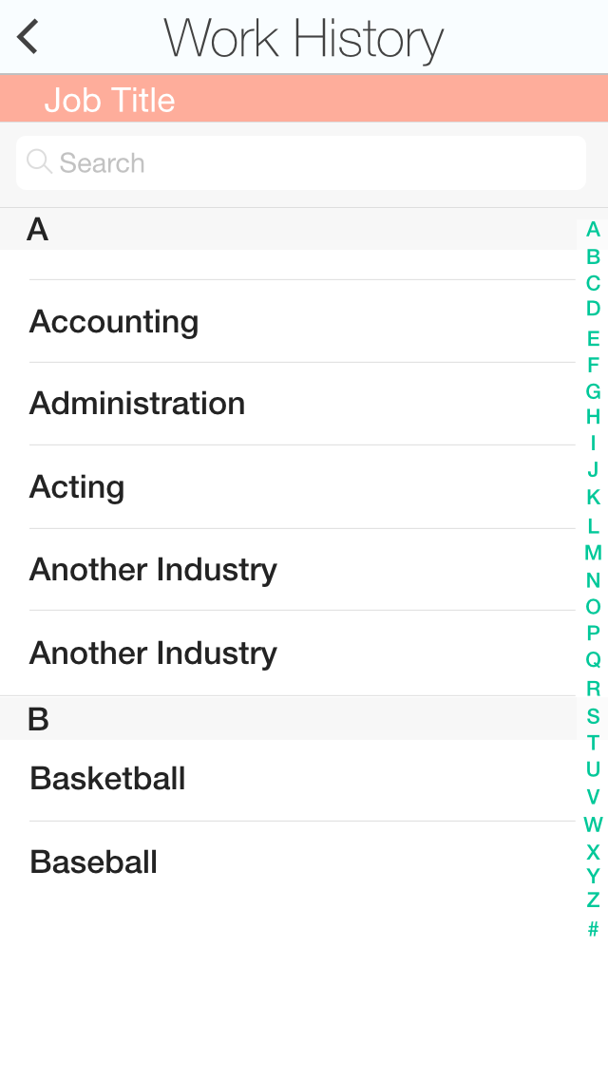
Job title pulls from a database of options.

Slide 21
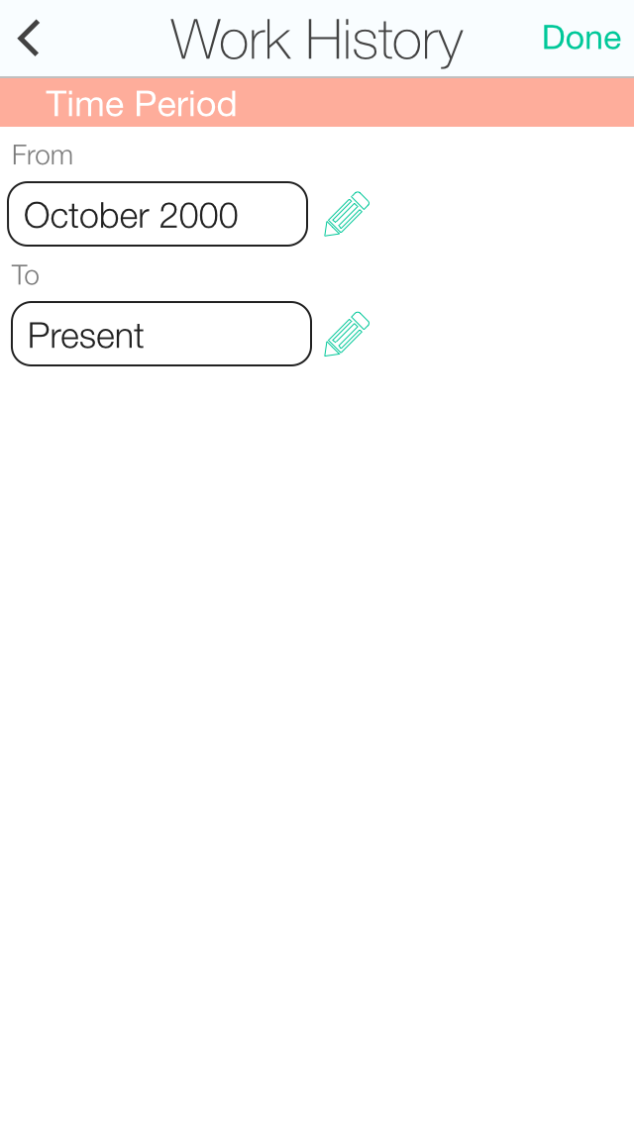
Tapping on the time period changes the UI so you can edit the To and From time periods.

Slide 22
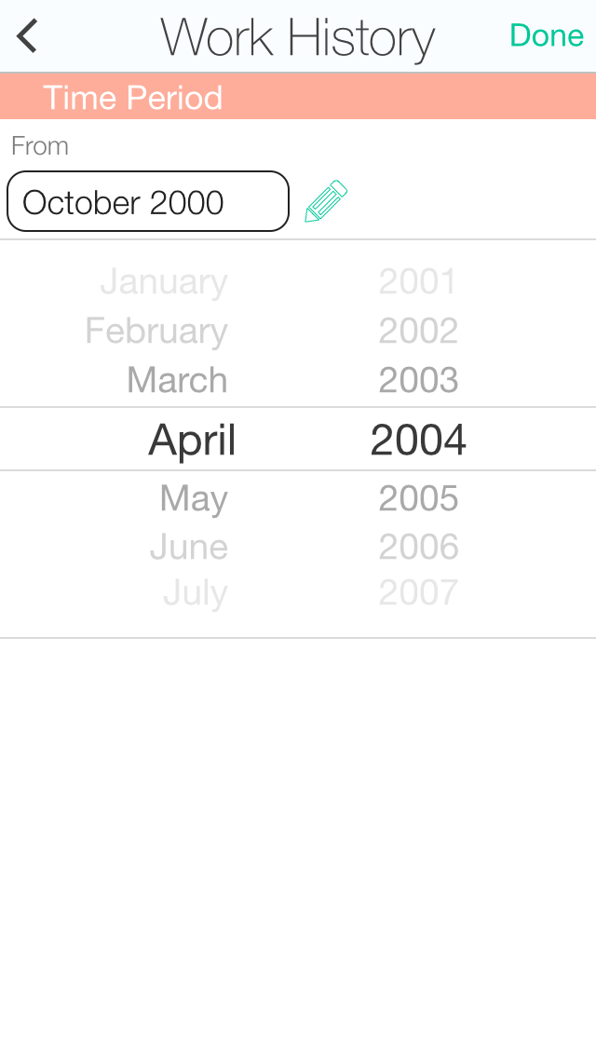
The From time field brings up a list of all the months on the left and a year list on the right in a standard iOS view.

Slide 23
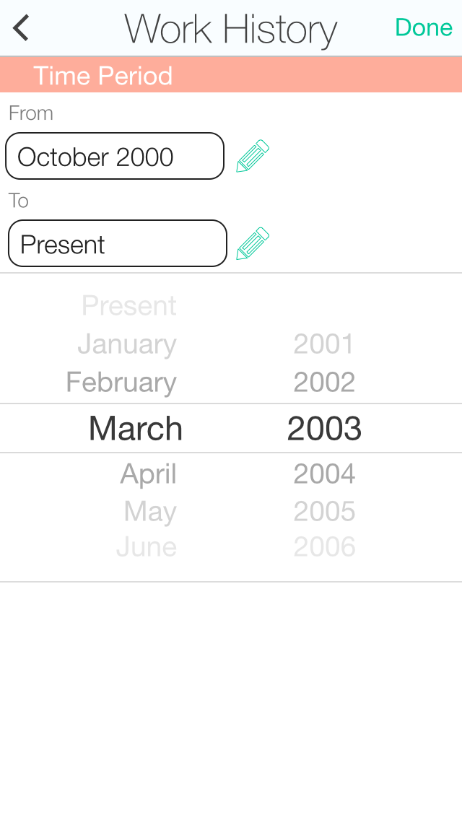
The To field is just like the From field, however it has a Present at the top of the list before January.

Slide 24
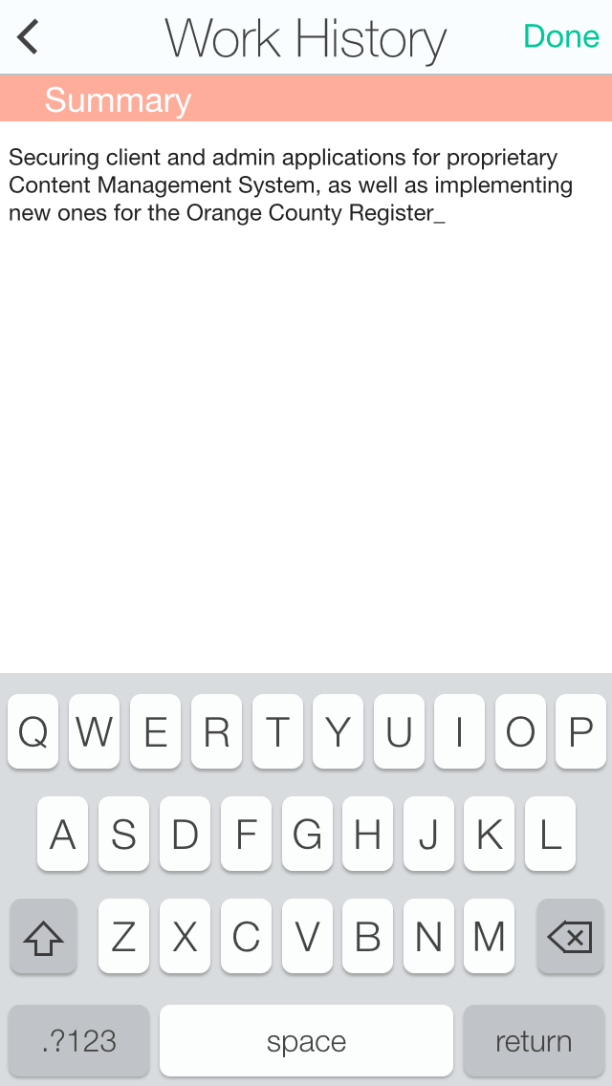
Editing the Summary brings up the keyboard and the entire text is editable.

Slide 25
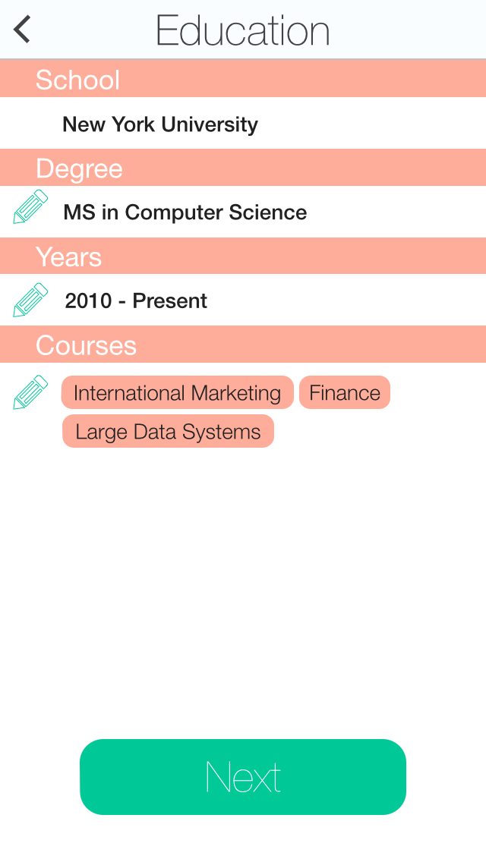
The Education view will allow the user to enter in details of their education with School Name, Degree, Years and Courses.

Slide 26
Repeat the process for all Education entries on the list.

Slide 27
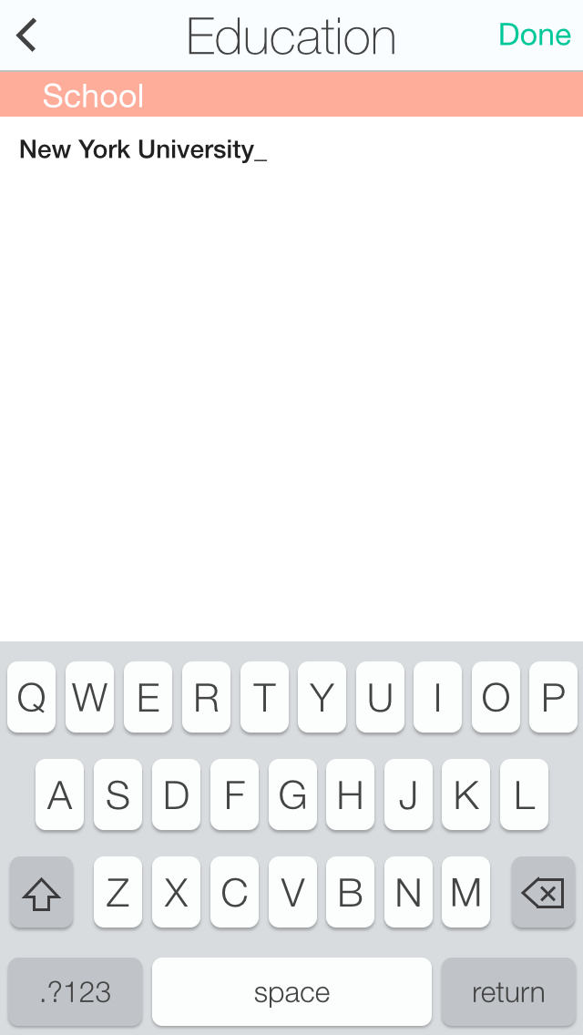
Editing School brings up the keyboard so the name of the school can be entered.

Slide 28
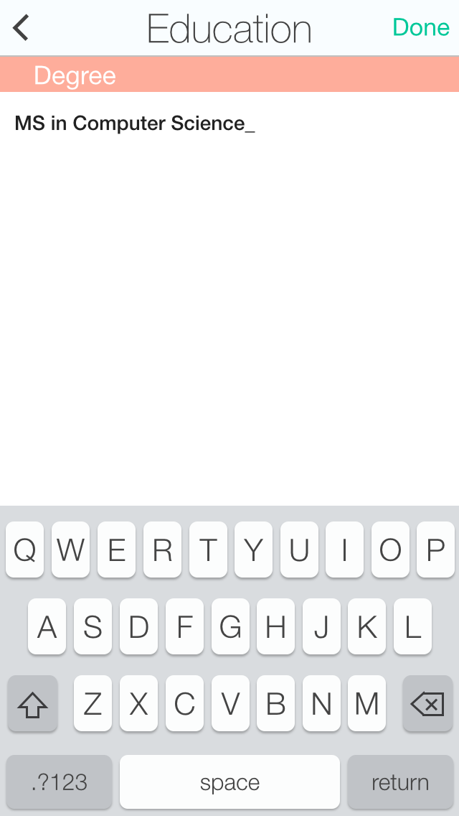
Editing Degree brings up the keyboard so the name of the degree can be entered.

Slide 29
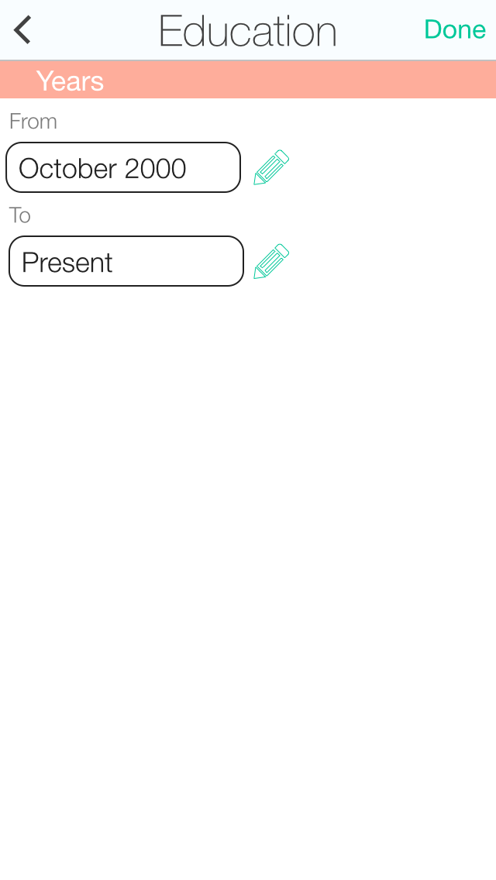
Just like the job history years, the education years field lets the user pick the date and years they attended school. Each edits independently.

Slide 30
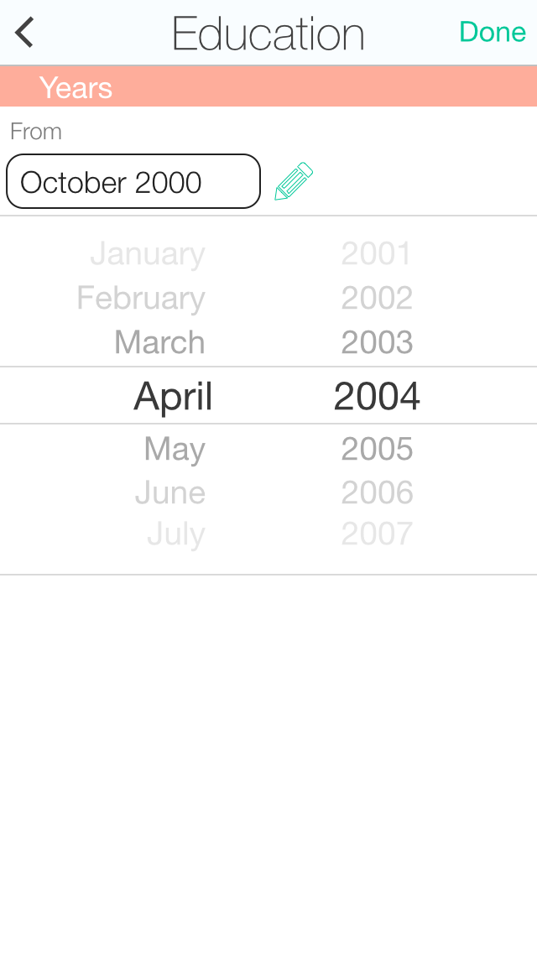
Just like the job history years, the education years field lets the user pick the date and years they attended school. Each edits independently.

Slide 31
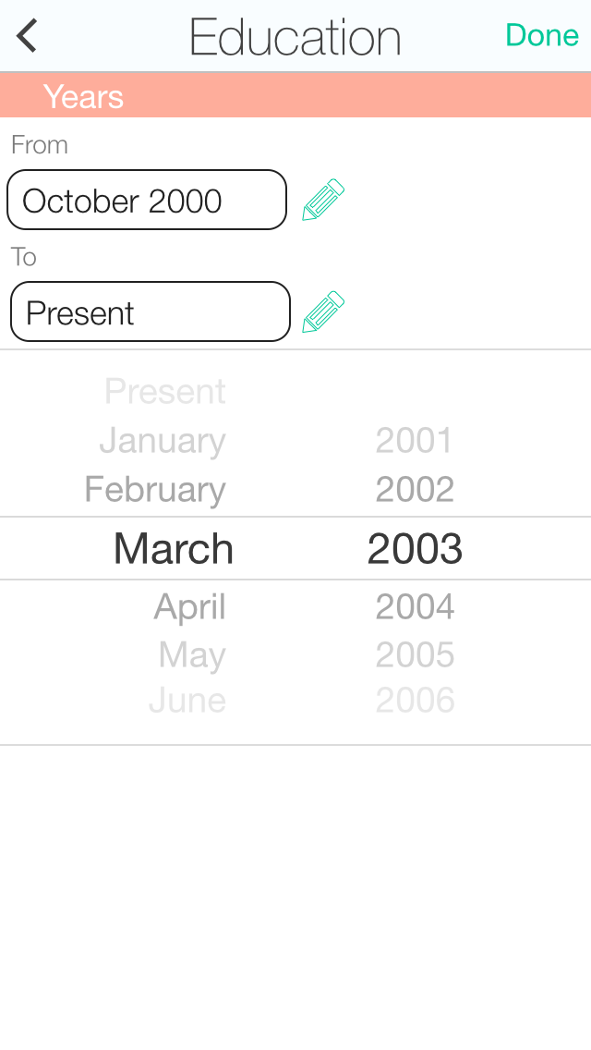
Just like the job history years, the education years field lets the user pick the date and years they attended school. Each edits independently.

Slide 32
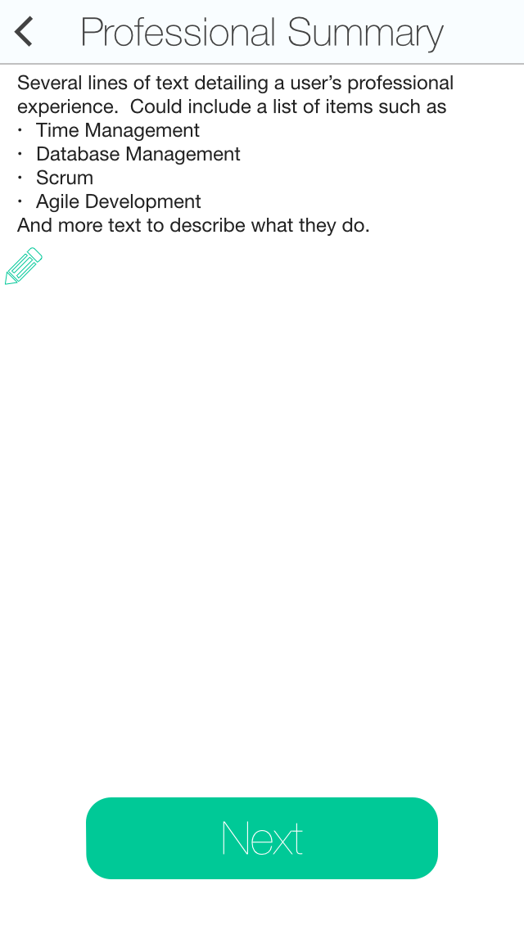
Professional Summary allows the user to fill in information about themselves.

Slide 33
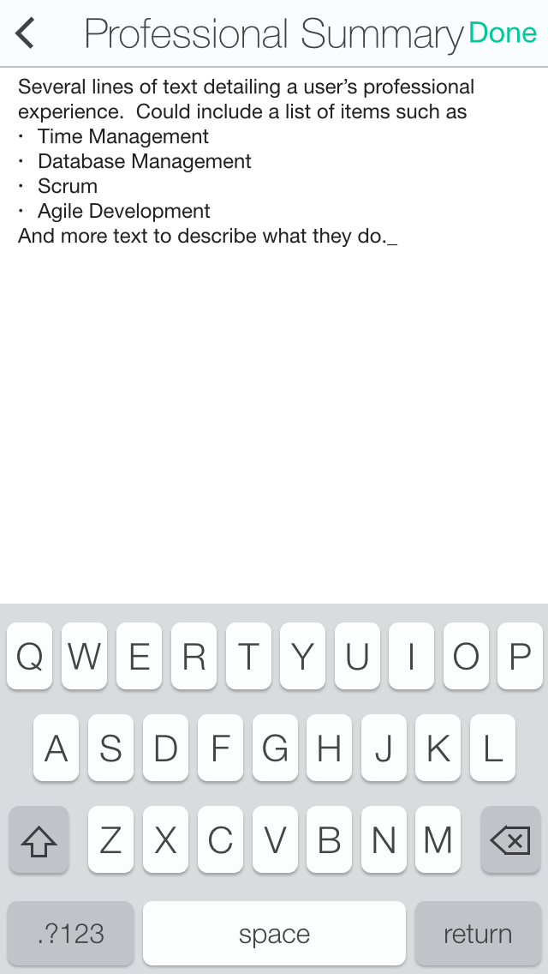
Tapping on the text allows the user to pull up the keyboard and edit their background text.

Slide 34
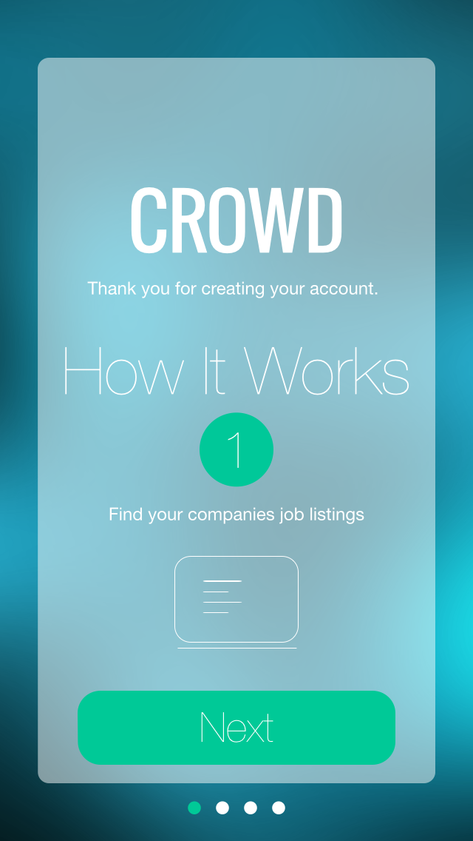
Now that a user has created an account, we run them through a quick introduction to the app.

Slide 35
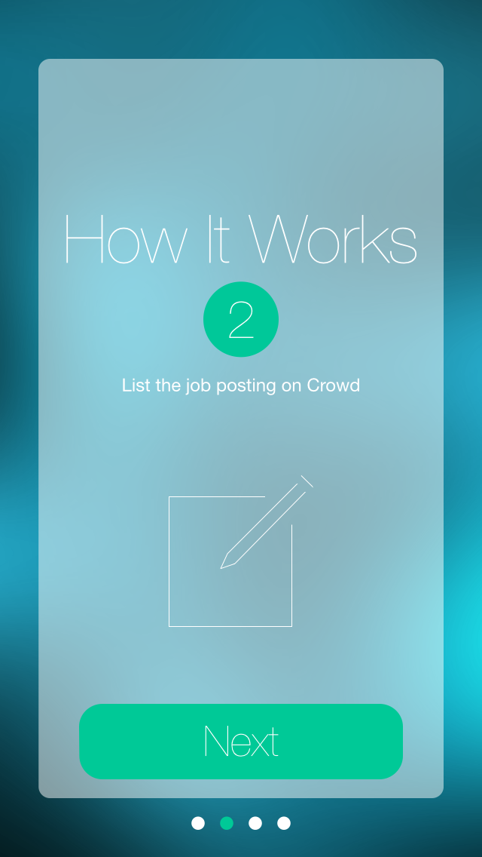
Now that a user has created an account, we run them through a quick introduction to the app.

Slide 36

Now that a user has created an account, we run them through a quick introduction to the app.

Slide 37
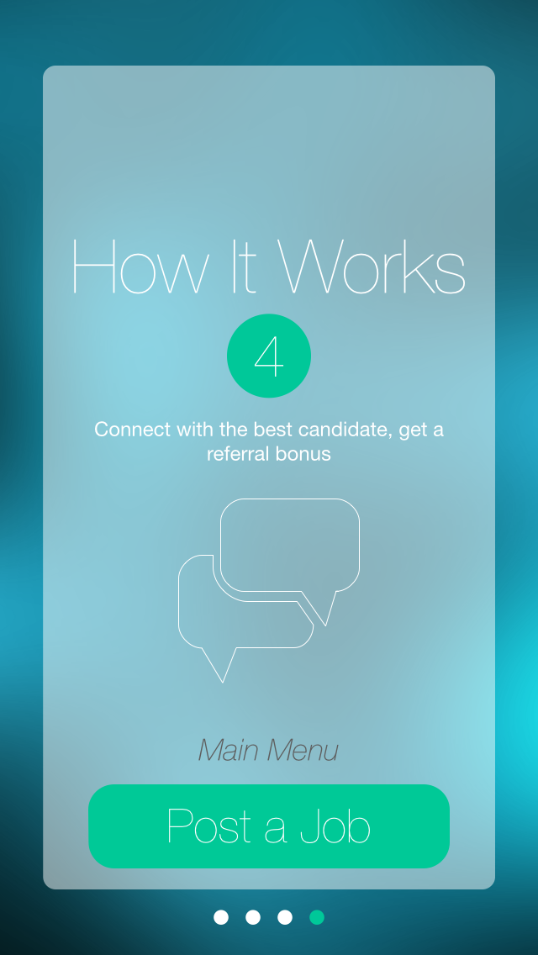
On the last screen we highlight the posting of a job, however they can also press “Main Menu” to go to the main menu and not post a job.

Slide 38
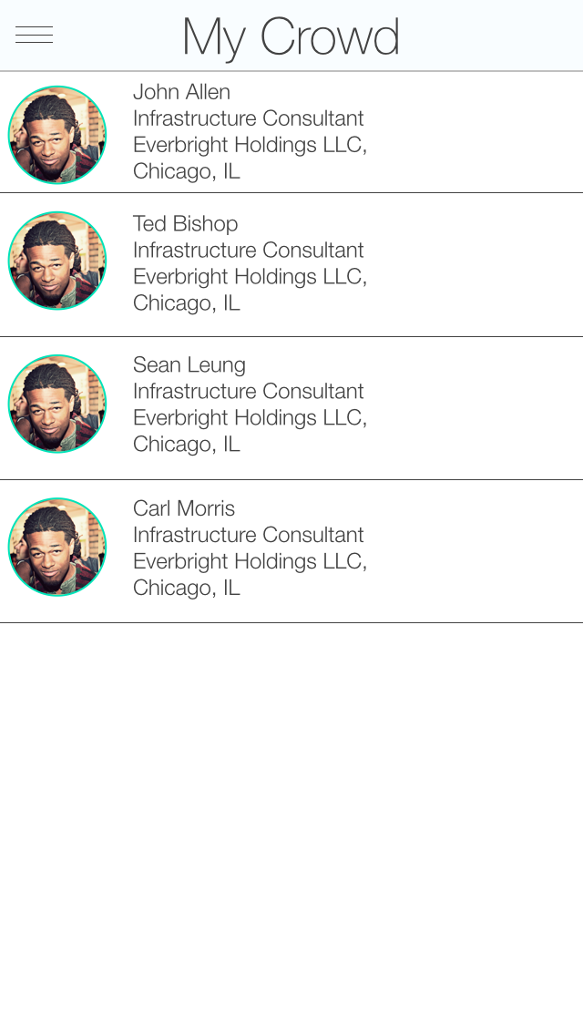
My Crowd, this is the main view of the app. When it opens up, it opens here. Before a user is following anyone, we will have messaging here about how to use the app and follow people.

Slide 39
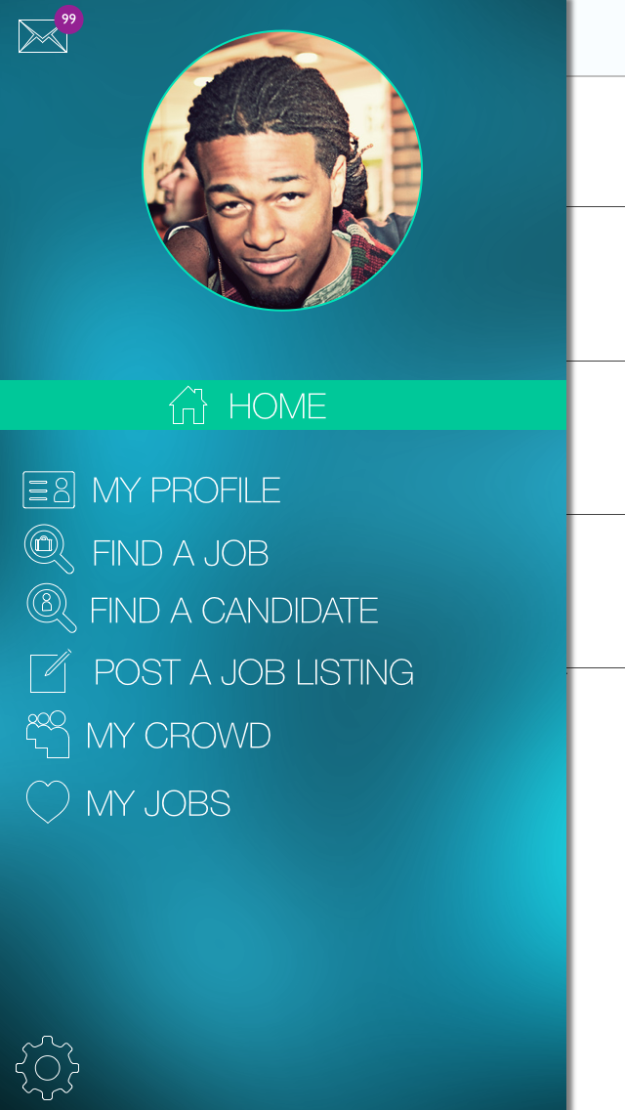
The menu is accessible from nearly every view in the app. It is the quick navigation to other parts of the app. It will slide in from the left.

Slide 40
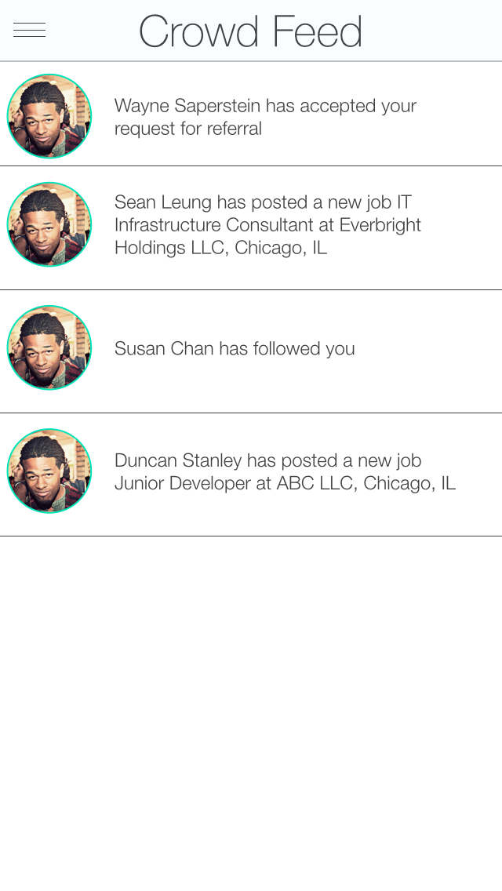
Crowd Feed, an activity feed of what crowd users are doing.

Slide 41
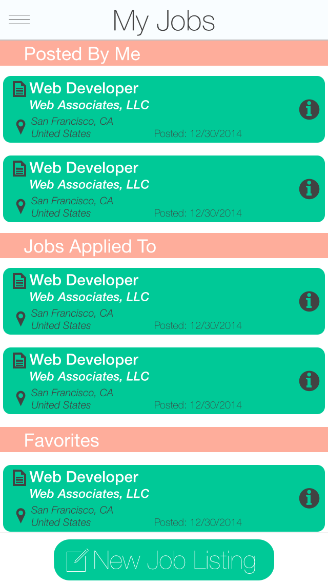
My jobs lists jobs I have favorited and jobs I have posted. If I have no jobs posted by me, the header will not be shown, likewise if I have not favorited any jobs that header will not be shown.
Anchored to the bottom is a “New Job Listing” button which will begin the new job wizard.

Slide 42
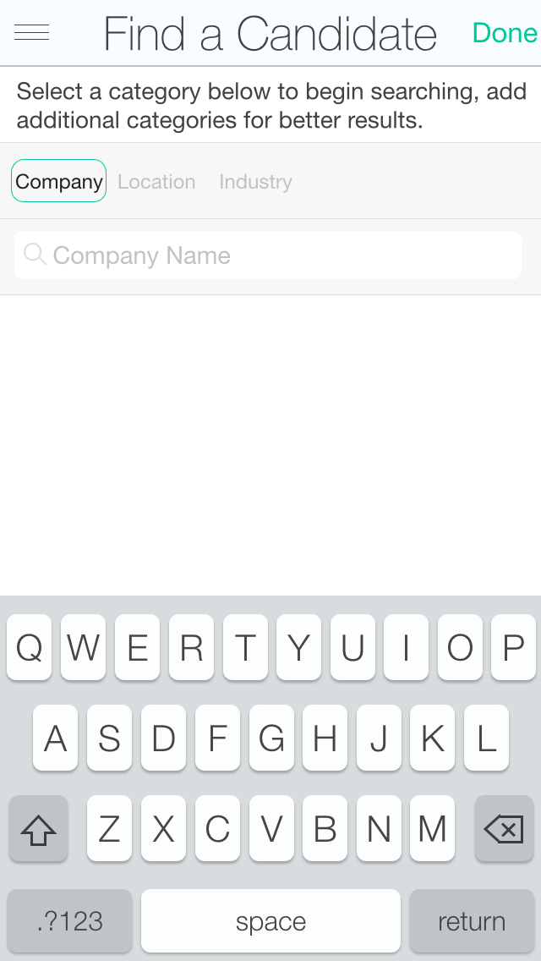
Finding a candidate begins with a search, the user can search for Company Name, Location and Industry.

Slide 43
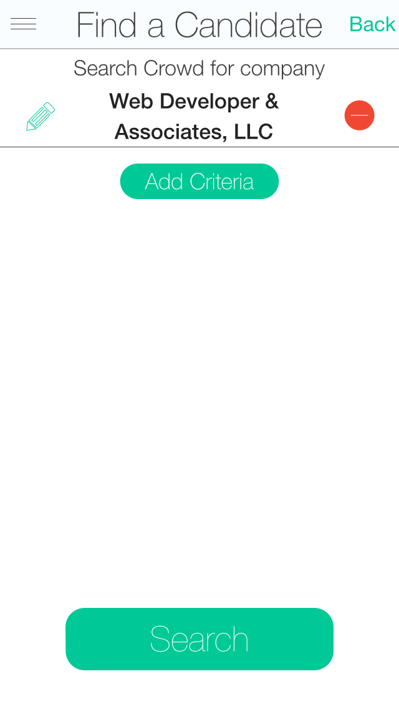
Once a user has searched for a company, in this case name they can refine the search by adding criteria go back, delete the search or search.

Slide 44
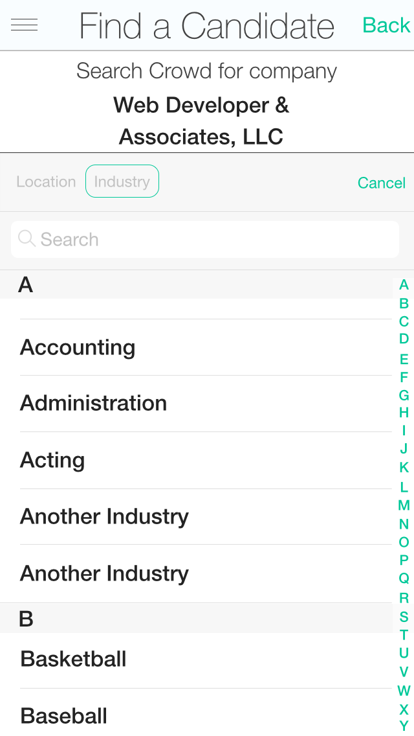
The user can now add a 2nd search item, in this case the Industry, they can also go back and start the search over, or cancel adding criteria.

Slide 45
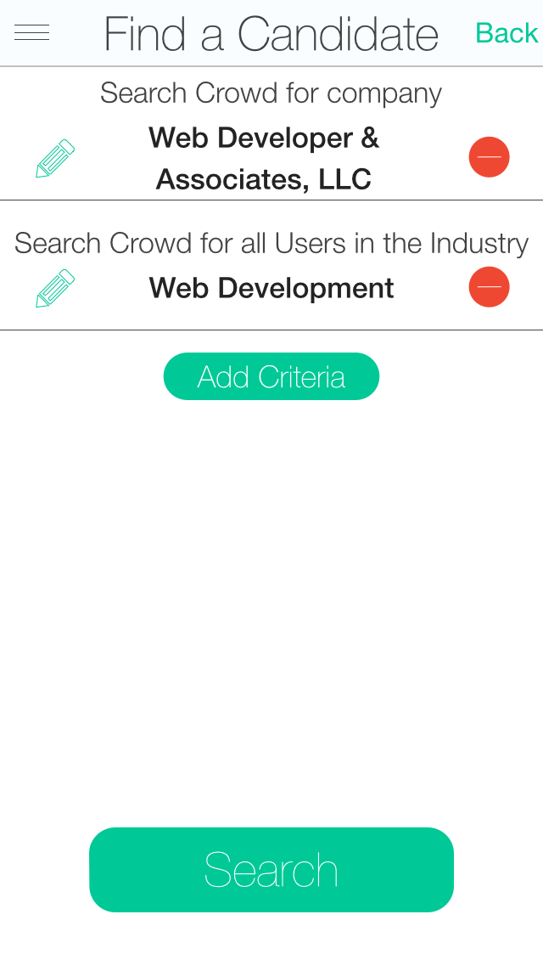
The user now has two search criteria, and can refine the search with more criteria, delete a search item, refine a search item start over or search.

Slide 46
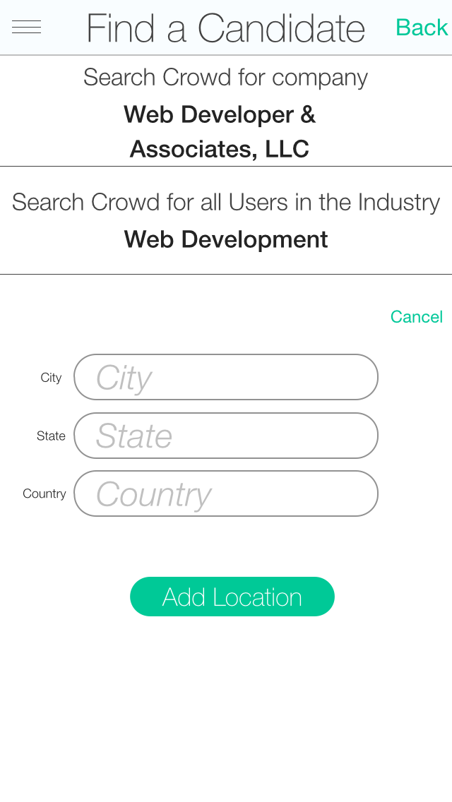
Now the user is searching for a Location.

Slide 47
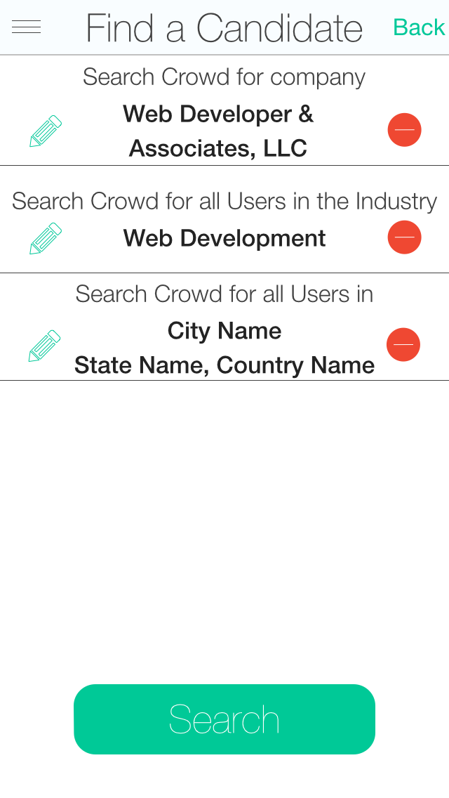
The user has 3 search criteria, and can add one more, refine the searches, delete the searches, start over, or search.

Slide 48
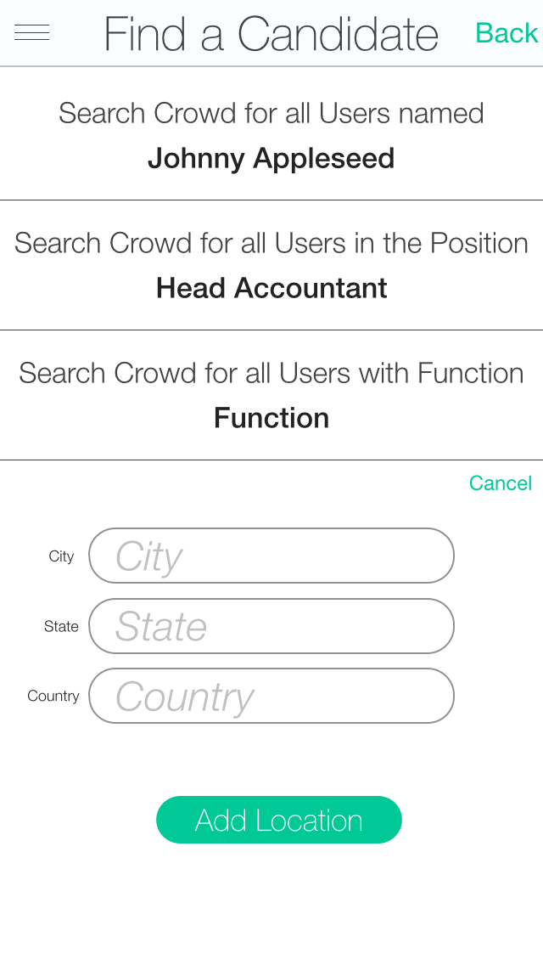
Searching location requires the user to type in a City, State and/or Country.

Slide 49
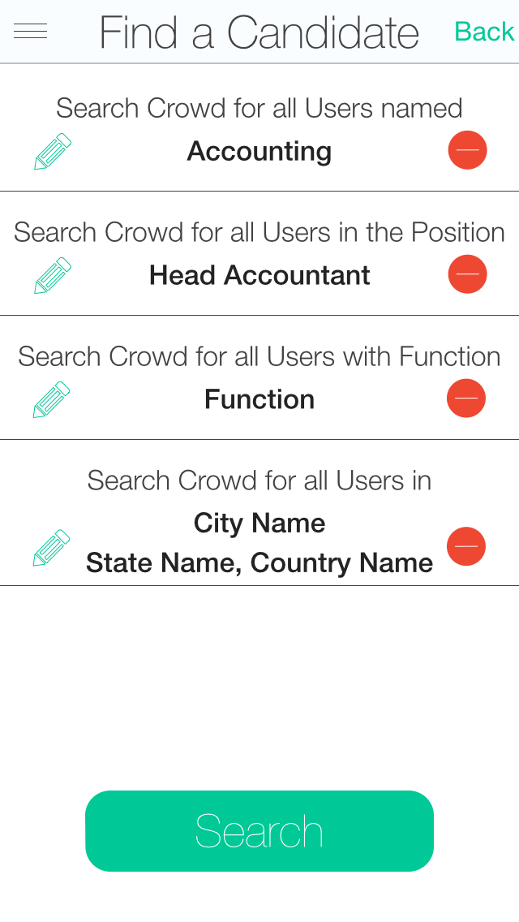
With the maximum search criteria listed, the user can edit searches, delete a search, start over or search.

Slide 50
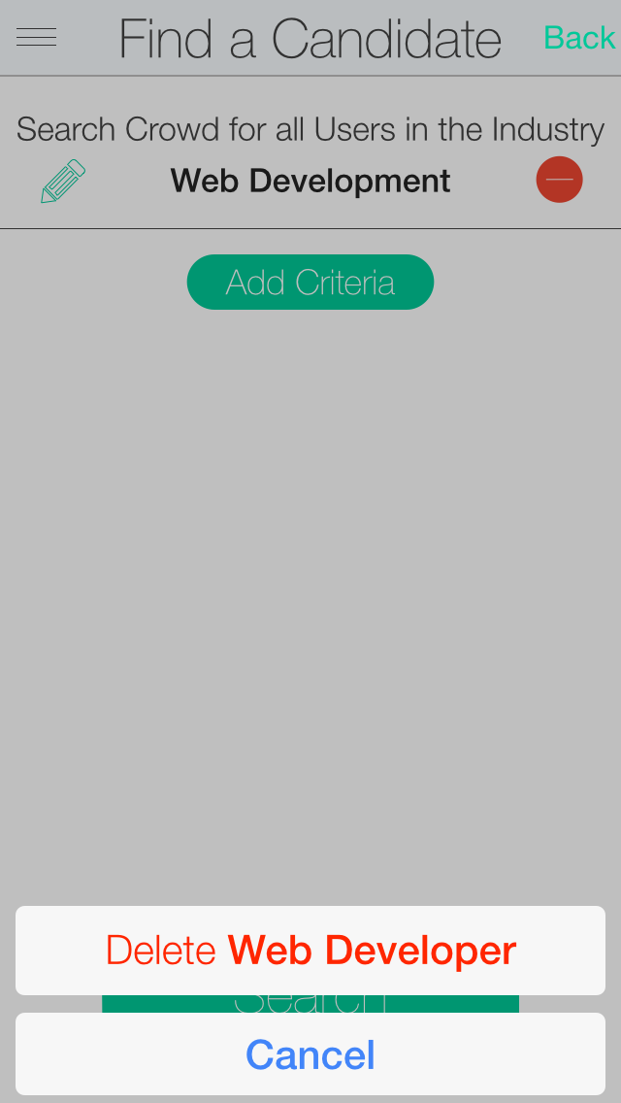
When deleting a search, the user is prompted to confirm.

Slide 51
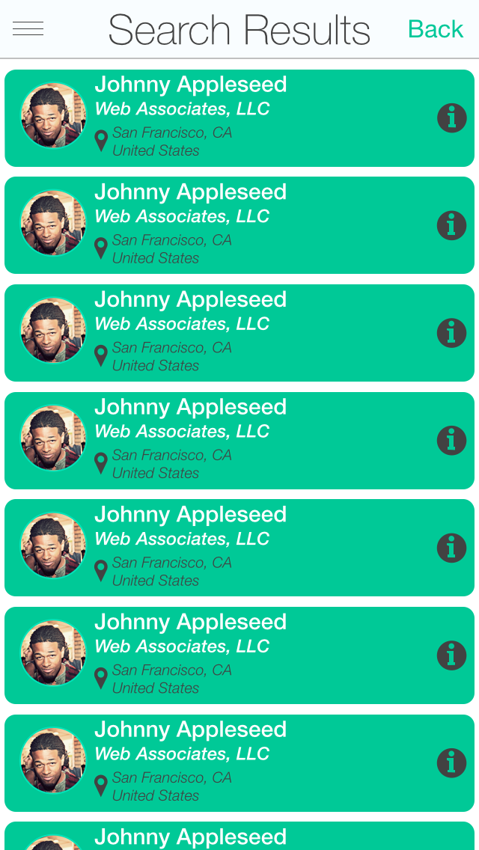
Search results for candidates list the candidate and his current employer and location, and a small portrait.
Tapping on the “i” button will unfold the list item to show detailed information.

Slide 52
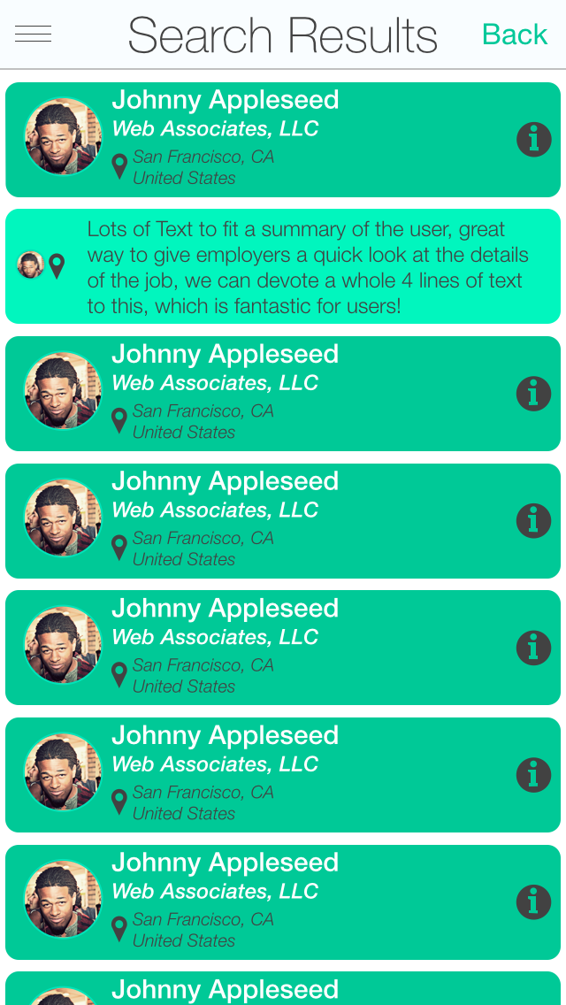
When unfolded the list will show up to 4 lines of summary text about a person.
Tapping on the left side of the fold will return the list to the previous view.

Slide 53
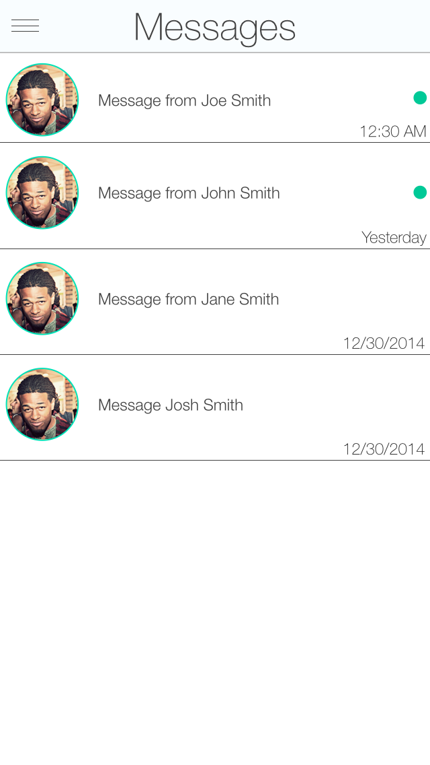
Messages collect your messages from different people. Tapping on a message will bring you to the full data of the message.

Slide 54

The message view lists your entire conversation with a person, with the newest at the bottom. You can send a message to someone, or an attachment (done via the + button). Attachments will be called out as a link with a name. For example one might say “Job posting” or “Link to Website”.

Slide 55

Pressing the + button allows you to attach an item to a message. This can be a Link to a Job or a User, or a link to a website.
Note: I’m looking to expand this to including attaching a file such as a PDF or a Doc file.

Slide 56
The Link to Content found in a message can link to both internal and external sources.
For example: it could link back to a job posting, or it could link to a url.
Back to Guide

Slide 57
Settings are to be determined once we know the full range of settings required.
Back to Guide

Slide 58

Your Profile. It is similar to view another person’s profile, except you can make edits. Tap on a pencil or section to make an edit to that section.
A profile is larger than one screen, the user will be able to freely scroll up and down. Because we cannot do that here, use the button below to scroll down.
Scroll Down

Slide 59

Your Profile. It is similar to view another person’s profile, except you can make edits. Tap on a pencil or section to make an edit to that section.
Scroll Up

Slide 60

The user has completed his or her profile, and is shown the finished results. They can then make edits or start using Crowd.

Slide 61

Finding a Job begins here. You can pick to search, Industry, Position, Function or Location. Once you select a category, you then pick from a choice listed below. You can use the search to get to the choice faster.

Slide 62

Once you have selected a search item, you can either Search, add additional criteria, change the search, or delete it.

Slide 63

Deleting a search item prompts for a confirm.

Slide 64

Adding additional criteria. In this example the user is adding a Position. They are already searching Accounting, so this adds additional search criteria.

Slide 65

Just as before the user can Search, add more criteria, edit a search or delete a search.

Slide 66

There user is again refining the search even more, this time for Function.

Slide 67

As with previous screens, the user can now Search, Add Criteria, Edit a Search or Delete a Search.

Slide 68

The final search criteria, this time the user will enter a City, State and/or Country.

Slide 69

With all the criteria filled out, the user can choose to Search, Edit a Search, or Delete a Search.

Slide 70

This view lists all jobs posted by an individual. This will need a message for when the user has not posted any jobs.

Slide 71

The search results, list the Job title, the company, the location, date posted and information.
Tapping on the “i” button will cause the label to switch modes and provide more quick information about the job.

Slide 72
After pressing the “i” button the map unfolds showing 4 lines of text, very useful to learning about a job.

Slide 73

A job posting. Contains all the required information about the job, as well as links to the user who posted it, the ability to favorite it, the ability to apply for the job and the ability to share it.

Slide 74

When applying for a job, we have a confirm.

Slide 75

Once applied, the user can still favorite a job, get info about the poster, and share the job.

Slide 76

When a job posting is favorited, it gets a bookmark (just like people who are followed).

Slide 77

When sharing a job posting, the share sheet comes up. This job can be shared to social media or external apps such as Messages and Email.
The user can also choose Message which will allow the user to share this Job with another Crowd user. I’m working out how this works with iOS.

Slide 78

When viewing a job the user has posted,the user can make edits to the job. Additionally they can Mark a job as filed, Share the job and Delete the job.

Slide 79

When choosing to delete a job, a user is prompted to confirm.

Slide 80

When a job is Filled, it is still on the system, and a user can reopen the job if for some reason it does not become filled.

Slide 81
The job can be shared on social media, or sent to external apps such as Messages or Mail.
A job can also be shared as part of a message.

Slide 82

Another User’s Profile. Has all of their information, as well as the ability to Follow that user, Message that user, see all Jobs that user has posted and share that user.

Slide 83

Sharing a user allows you to send to social media, external apps such as Messages and Mail, as well as to another Crowd user as a message.

Slide 84

This user has been followed, indicated by the bookmark, as well as the change from Follow to Unfollow button.

Slide 85

When starting the Post a new job, the user is taken through a series of steps to fillin the information about the job.

Slide 86

Entering the location of the job by City, State and Country.

Slide 87

Selecting the industry uses the same database as searching jobs.

Slide 88
Selecting the industry uses the same database as searching jobs.

Slide 89

Once an industry is selected, the user can go back or edit their choice, or go to the next part.

Slide 90

Once an industry is selected, the user can go back or edit their choice, or go to the next part.

Slide 91

Next the use selects the Function of the job from a list.

Slide 92

The user can edit the Function, go back to the previous section or go to the next part of the wizard.

Slide 93

Next the user selects the Position, again pulling from a list of choices.

Slide 94

The user can edit the position, go back to the previous section or to the next part of the wizard.

Slide 95

The user next describes the Rolls and Responsibilities of the position. This is a large textfield where the user can type a lot of info.

Slide 96

Likewise, Qualifications and Requirements allows for a lot of text.

Slide 97

Finally Employer Introduction allows the user to write a brief description about the employer.

Slide 98

This is the screen where the user can attach an external URL to the job posting, this is optional.

Slide 99

The job has been created but not posted yet, giving the user a chance to review the job, and make edits before posting.

Slide 100

If the user attempts to leave the job before it is posted, they are warned that leaving will lose all entered data.

